Slide 1
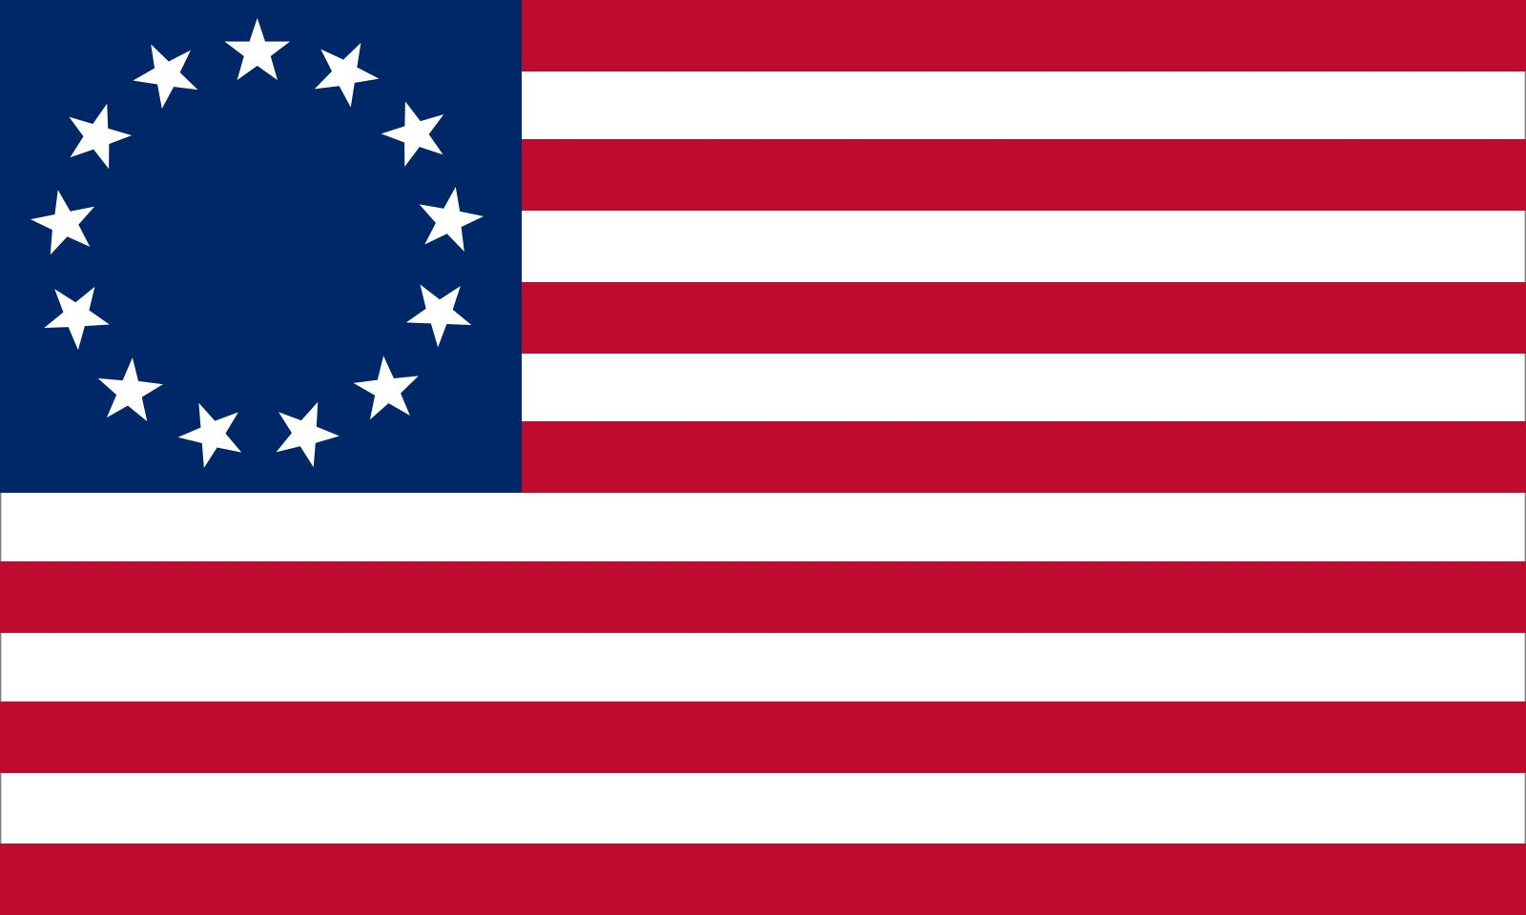


Notes:
Orange County Chapter 4th Annual Picnic. Mile Square Park, Fountain Valley CA

Slide 2

What is America 250?

Slide 3
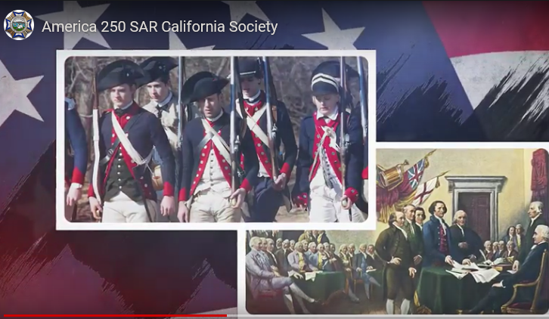
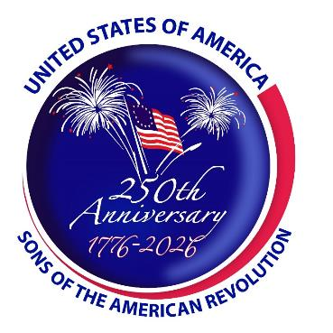

America 250 Minute

Slide 4

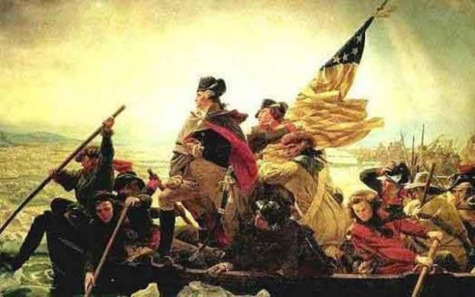
What is the 250 Minute?
Revolutionary War Timeline: 1764-1783
  Celebrate and draw attention to colonial ancestors
  Increase awareness of challenges, struggles, sacrifices
    Events: Revolutionary War Master List
    People
    Patriot Ancestors
Presentation Parameters
  Brief Five-Minute Presentations
    Formal or Informal: PowerPoint vs. 1-2 Page Script
    Battle of Alamance May 16, 1771
    George Washington (example provided below)

Slide 5
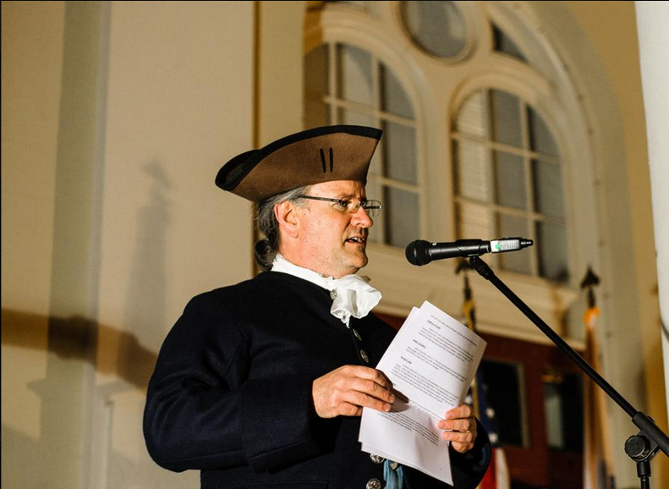
How to Give A Good Presentation

Slide 6

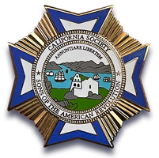
Presentation Resources
10 Tips for Improving Your Public Speaking Skills
  Brief overview of public speaking tips from Harvard Professional Development
10 Resources to Improve Your Public Speaking Skills
  Articles, tips, presentation ideas, and speech banks
12 Public Speaking Resources We Are Thankful For
  Curated list of top public speaking resources that make us better presenters
9 Tips for Making Beautiful PowerPoint Presentations
  Provides best practices for construction of PowerPoint slides

Slide 7
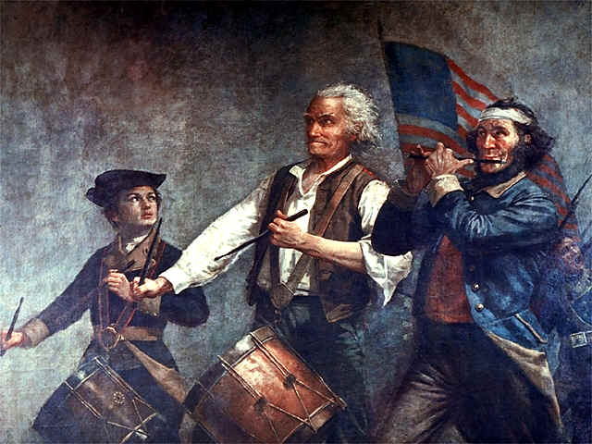
Revolutionary War Topics
Events
  Battles
  Founding Documents
  Governmental Origins
  Parliamentary Acts
  Proclamations
  Publications
  Rebellions
  Speeches

Slide 8
Revolutionary War - Timeline,
Facts, Events
The Revolutionary War on History.com
  Good overview and introductory articles on key people, events, and places
On This Day in History
  Daily posts about American Revolution events that occurred on that day
The Coming of the American Revolution: 1764-1776
  Massachusetts Historical Society provides contextual essays of key events
American Archives: Documents of the American Revolution
  Collection of original pamphlets, booklets, and newspaper articles
British Library: Online Gallery, the American Revolution
  Investigates course of the Revolution and its impact on America, Britain, Europe

Slide 9

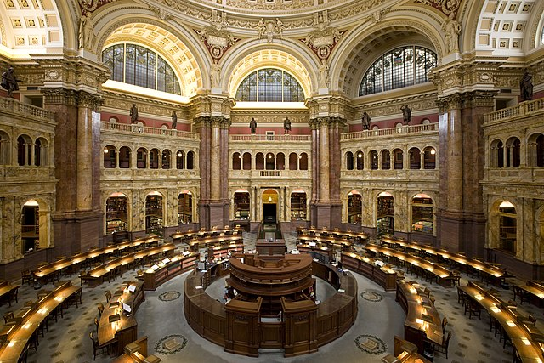
Library of Congress Resources
Revolution Resource Guide
Digital Collections
  Papers associated with key people
Today in History
  LOC overview of historic events
Revolution Online Resources
  Information and primary sources
External Websites
  Primary sources and related info

Slide 10
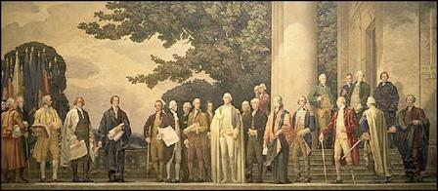
National Archives Records and Resources
The American Revolution
America’s Founding Documents
Pictures of the Revolutionary War
Images of the American Revolution Lesson Plan
1936 Faulkner Murals

Slide 11
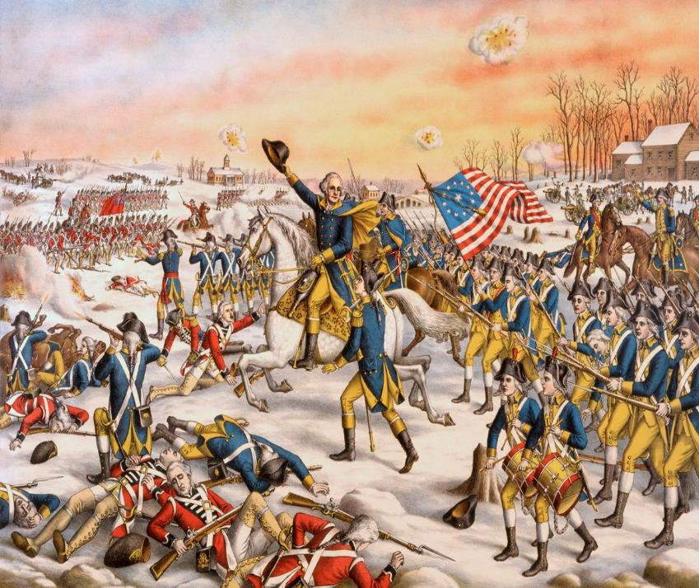
Revolutionary War Battles
Battles of the Revolutionary War
  List of battles with information
Revolutionary War Battles
  List of skirmishes/battles by year
Major Battle Maps
  Maps of battles with context
George Washington Battles
  Battles Washington participated in

Slide 12
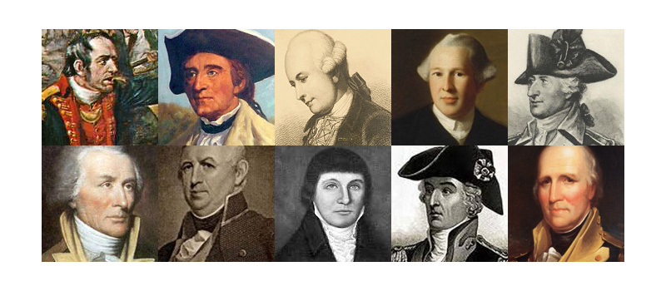
Revolutionary War Topics
People
  People connected to major/minor events
  Founding Fathers
  Military Figures
  Patriot Ancestors
  Patriots of Color
  Political Figures
  Women of the Revolution
  British Leaders
  British Loyalists

Slide 13
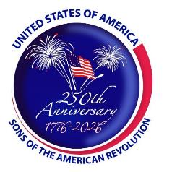
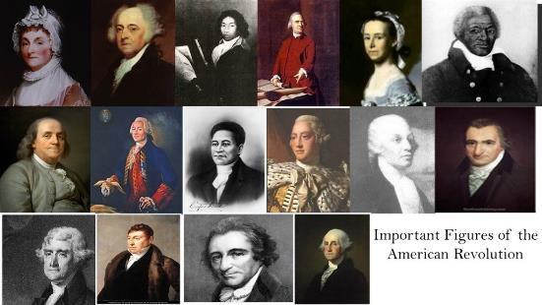
People of the American Revolution
Famous Americans of the Revolutionary War
  Extensive list with biographical details
Patriots of Color
  National Park Service overview of American Revolution Patriots of Color
People of the American Revolution
  National Park Service provides 178 biographies
Portraits in Revolution
  Artists, British, Colonials, Enslaved People, French, Germans, Natives, Spanish
Women of the Revolution
  Biographies of women and their critical role in the Revolution
100 of the Best Biographies of the American Revolutionary War
  Extensive list of major biographical books associated with the Revolution

Slide 14
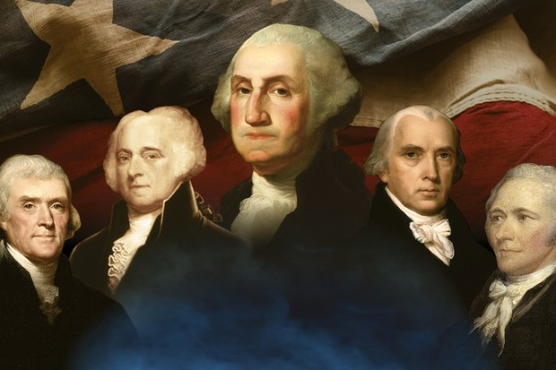
Founding Fathers Who Shaped the Nation
Founding Father Biographies
10 Facts: The Founding Fathers
Framers of the Constitution
  National Archives collection
American Founders Papers
  Library of Congress online papers
Founding Fathers Reading List
  List of books written by and about

Slide 15

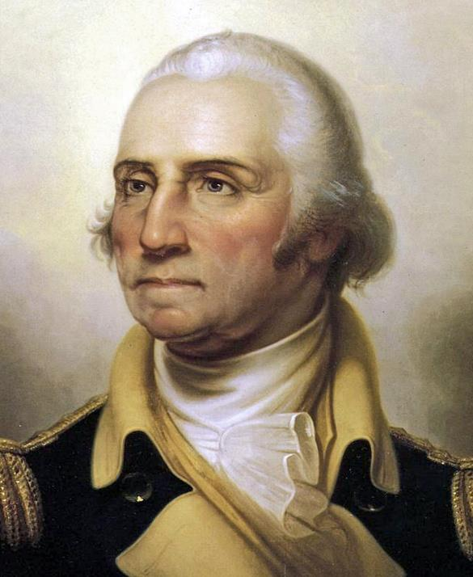
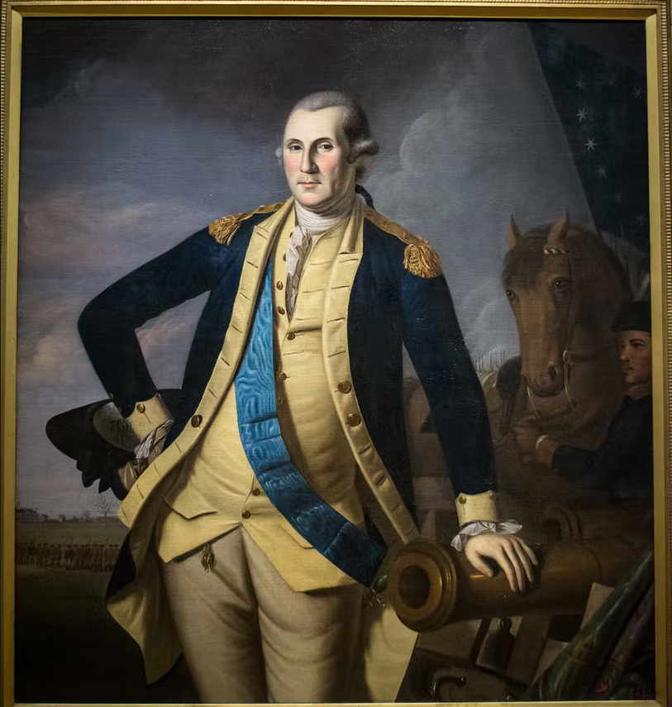

250 Minute Presentation Example

Slide 16
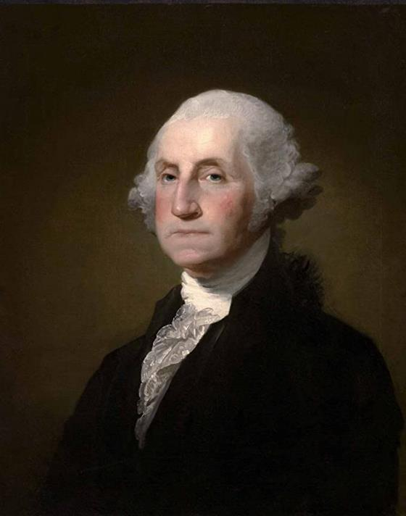

George Washington 250 Minute
February 22, 1732-December 14 1799

Slide 17
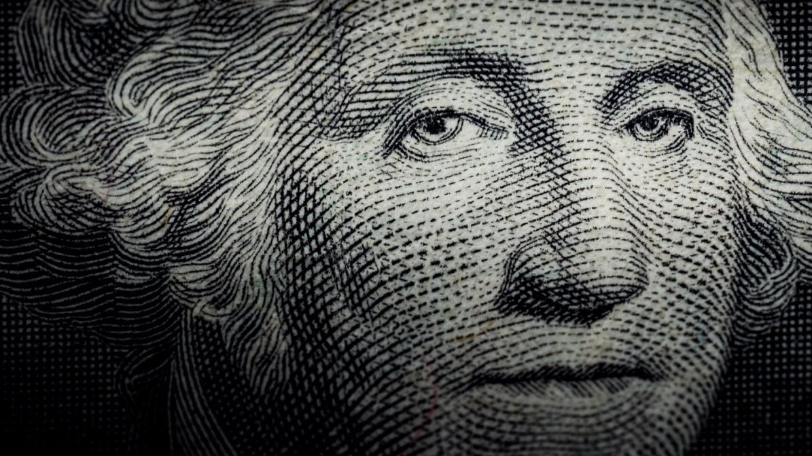

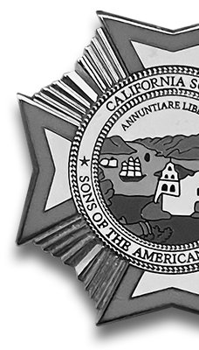
5 Little-Known Facts About George Washington
Source: History.com

Slide 18
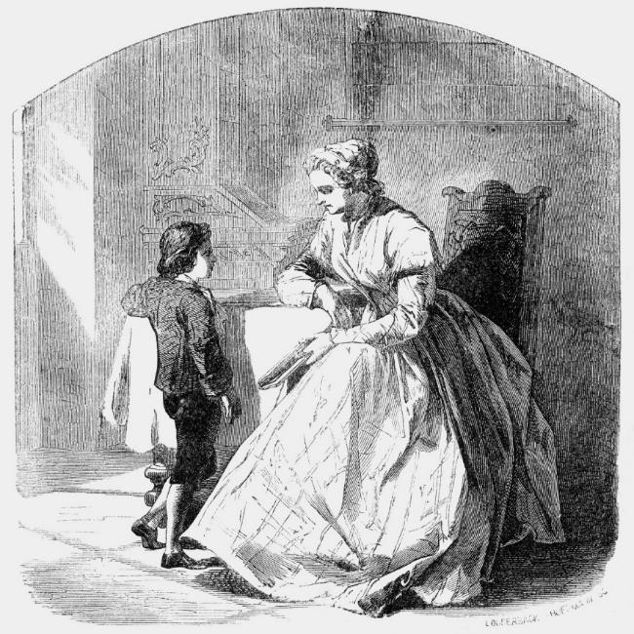
Washington only had a grade school education
Formal school ended when he was 11 after father died
Prevented similar education to ½ brothers abroad in England
Oldest child of six, Mary Washington taught him to run a tobacco farm
First job was a land surveyor at 16
Embarrassed by his stunted schooling

Slide 19
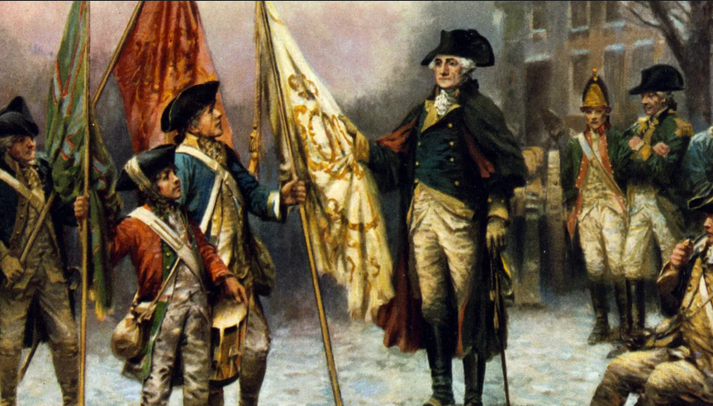
Washington wasn’t always a great general, but he was an excellent spymaster
Struggled with an army that was undermanned, untrained, and undersupplied
Secret Intelligence Network
Letters written in invisible ink
Female Agent 355
African-American double agent
Patriot tailor who collected dirt while making clothes for British officers

Slide 20
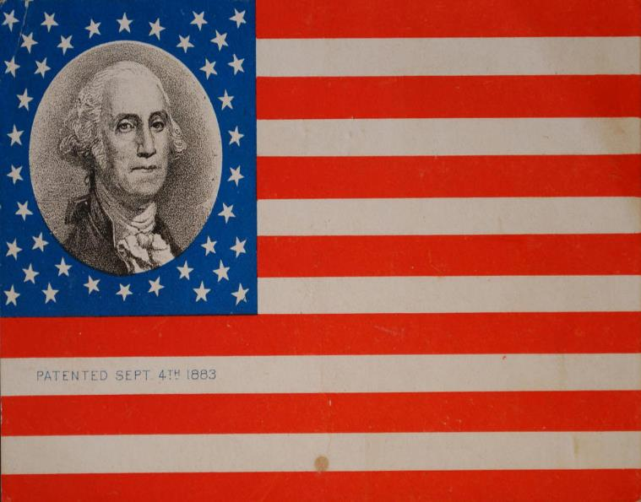

When he stepped down as commander-in-chief, he didn’t want to run the country
After 8 years on the battlefield, Washington was more than ready to return to Mount Vernon
1783 Circular Letter to the States
  Articulated benefits of Republicanism and detailed what he believed it would take for the American experiment to succeed
    Union of States must be robust and organized under supreme governing body
    Pay back debts accrued during war
    Militia need to be of a high uniform standard
    Peaceful and affectionate relationship between all citizens regardless of region

Slide 21
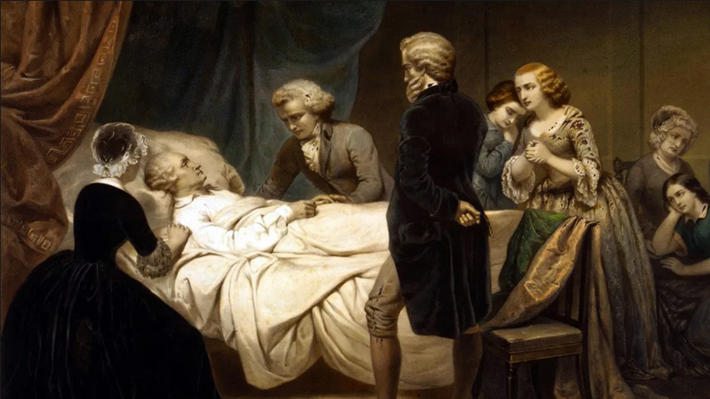

Washington was a tough man to kill
Diphtheria, tuberculosis, smallpox, malaria, dysentery, quinsy, carbuncle, and pneumonia
Survived drowning in ice clogged river, burning and massacre of Fort Necessity, two horses being shot out from under him and four bullets passing close enough to pierce his clothing—all in one battle
Ironically, it was the cold that did him in. Technically, it was epiglottitis an infection of the back of the throat that would be curable with antibiotics today.
Drs. effectively tortured him burning him to remove the sickness and draining him of 40 percent of his blood

